Slide 1
Order Management Implementation Patterns

Slide 2
Session Overview
Existing integration approaches
Orders – low to high maturity (6)
Results – low to high maturity (4)

Slide 3
Point to Point
Source
Destination
What If?
We need to upgrade one of the systems?
What if the two systems speak different ‘flavours’ of HL7?
What if data is needed from a third-party to enrich the message?
What if we need to send to multiple destinations?
What if we add a new system to the mix?
What if one system is offline?
Connecting 8 systems to each other requires 28 interfaces
Data forensics very difficult
How do we debug issues?

Slide 4
Middleware
Integration Engine
Source
Destination
What If?
We need to upgrade one of the systems?
What if the two systems speak different ‘flavours’ of HL7?
What if data is needed from a third-party to enrich the message?
What if we need to send to multiple destinations?
What if we add a new system to the mix?
What if one system is offline?
Connecting 8 systems to each other requires 28 interfaces
Data forensics very difficult
How do we debug issues?

Slide 5
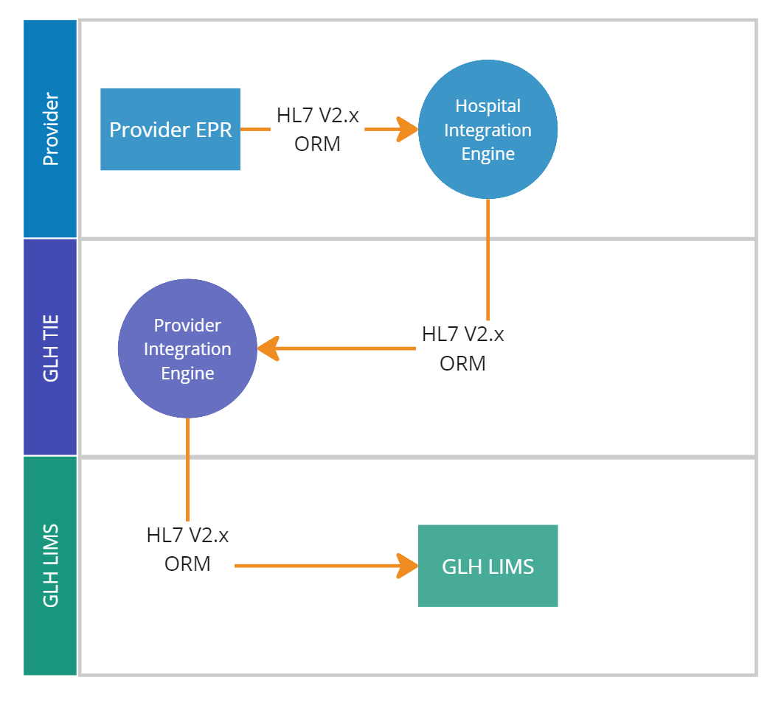
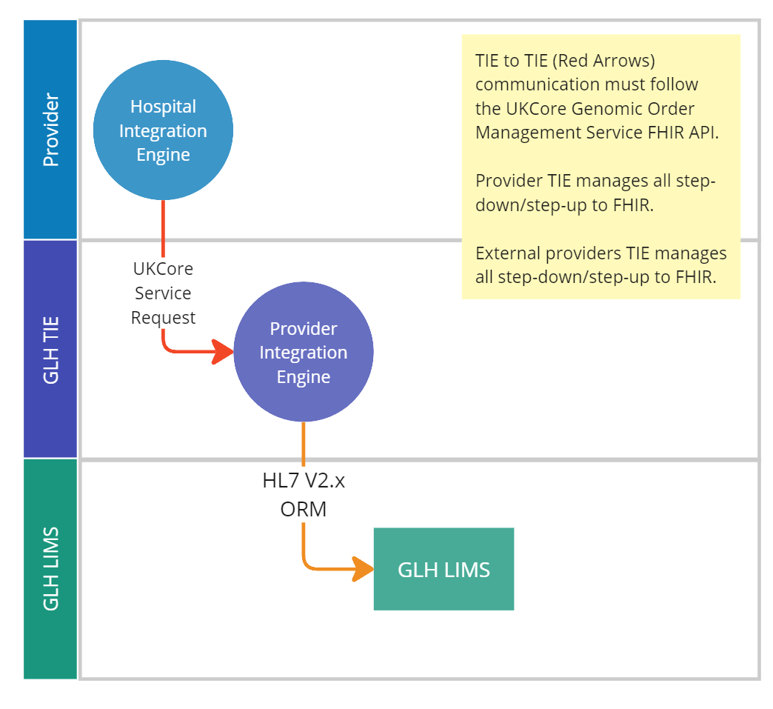
Orders Pattern 1

Slide 6
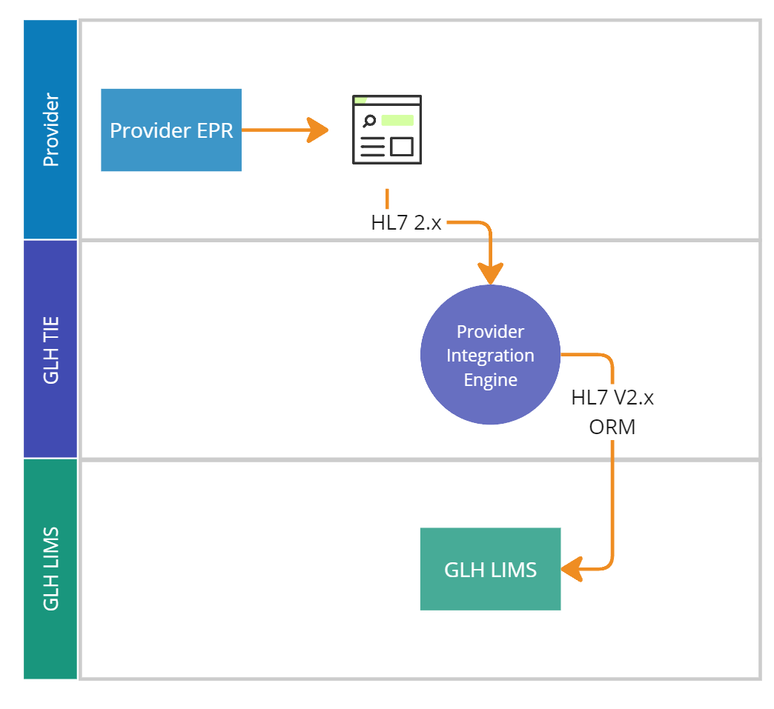
Orders Pattern 1b

Slide 7

Orders Pattern 2*

Slide 8
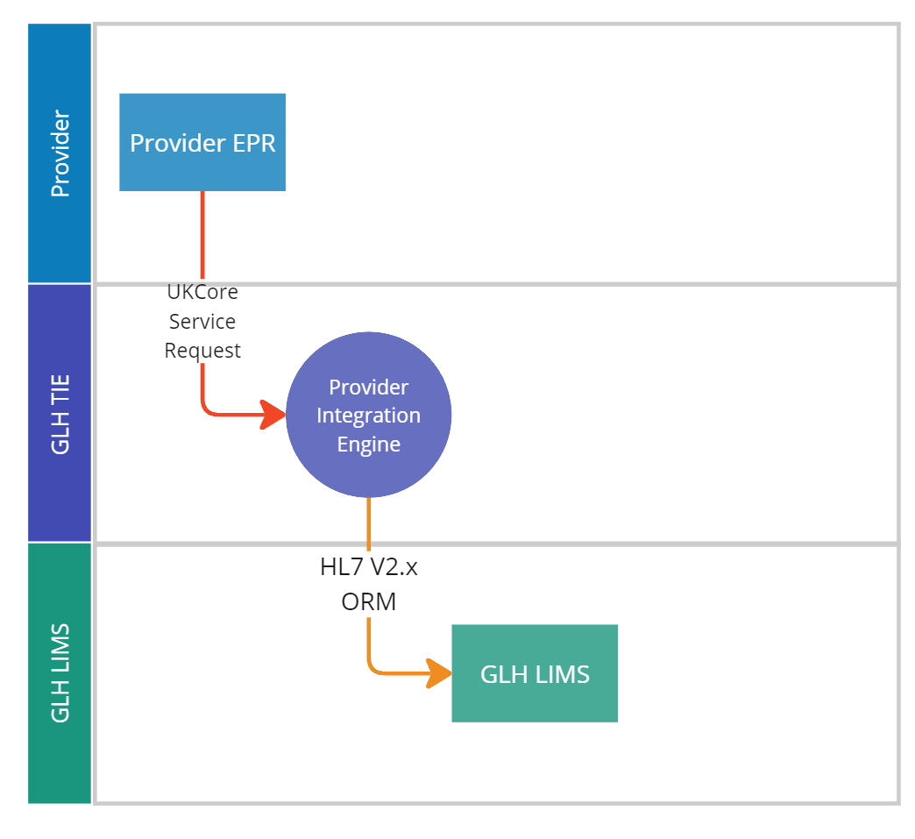
Orders Pattern 3

Slide 9
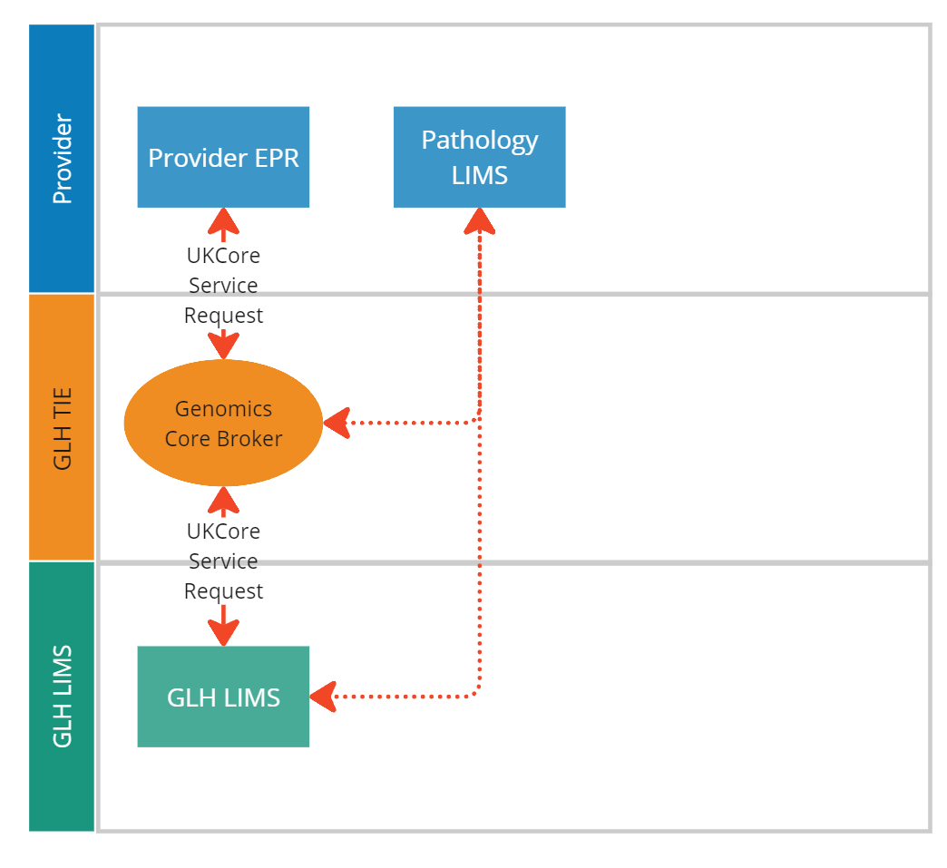
Orders Pattern 4

Slide 10
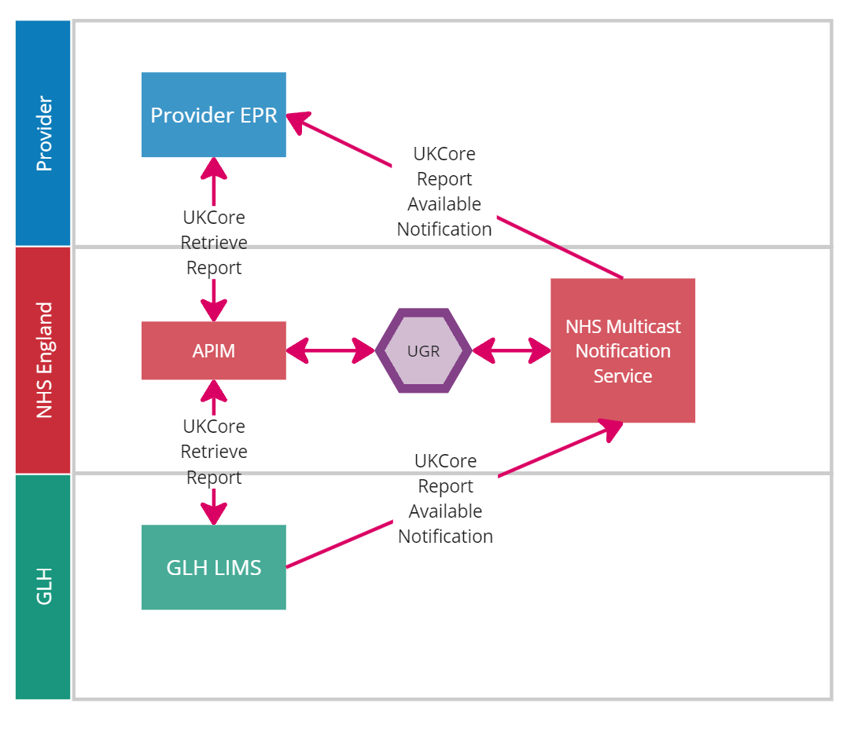
Orders Pattern 5

Slide 11
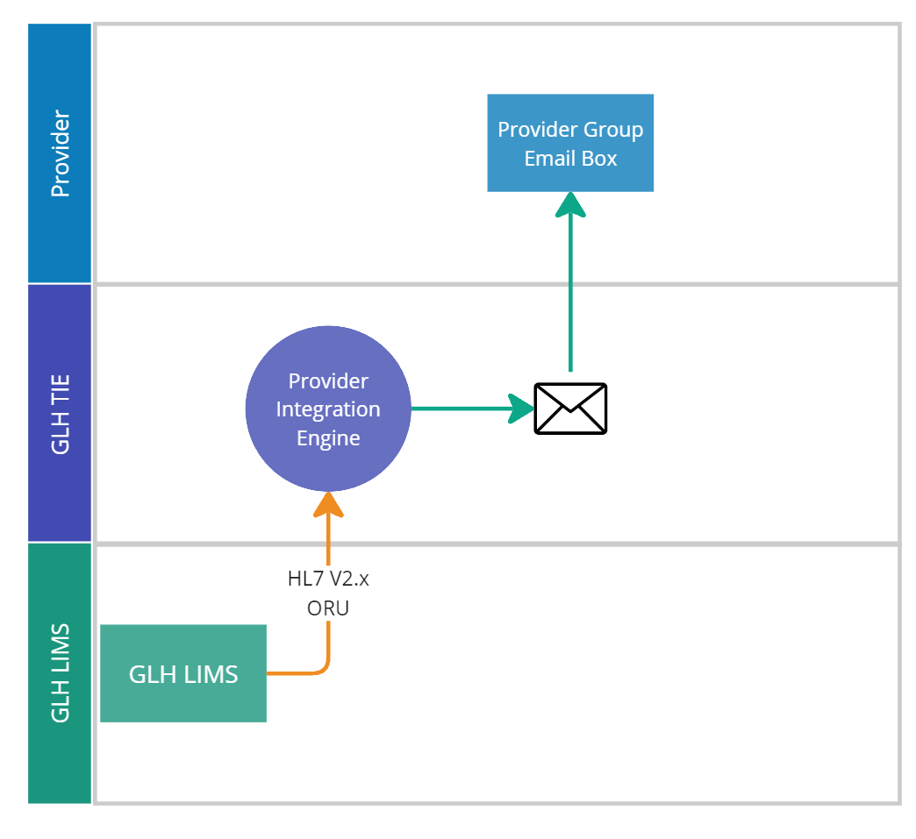
Results Pattern 1

Slide 12
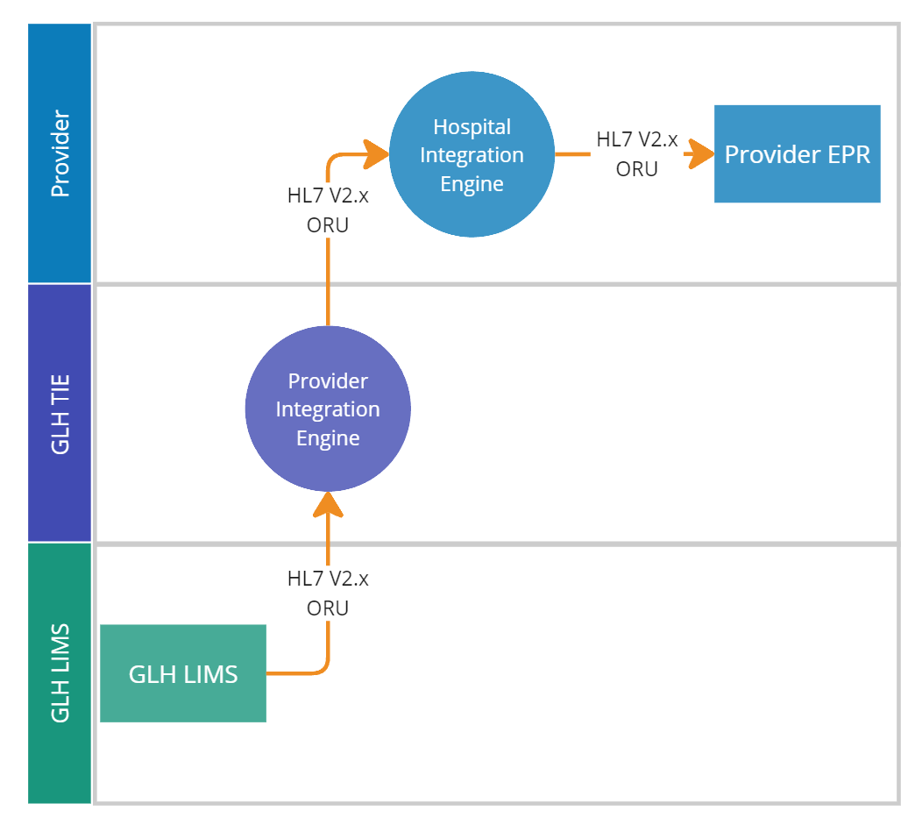
Results Pattern 2

Slide 13
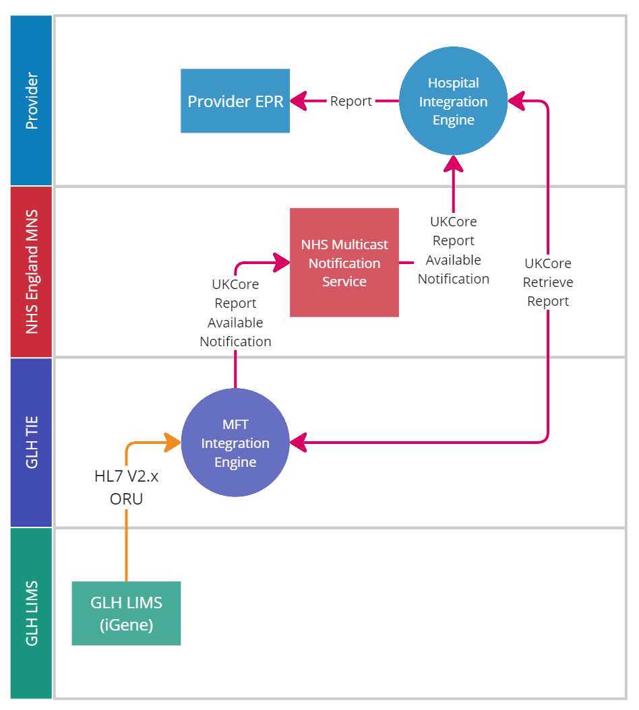
Results Pattern 3*

Slide 14
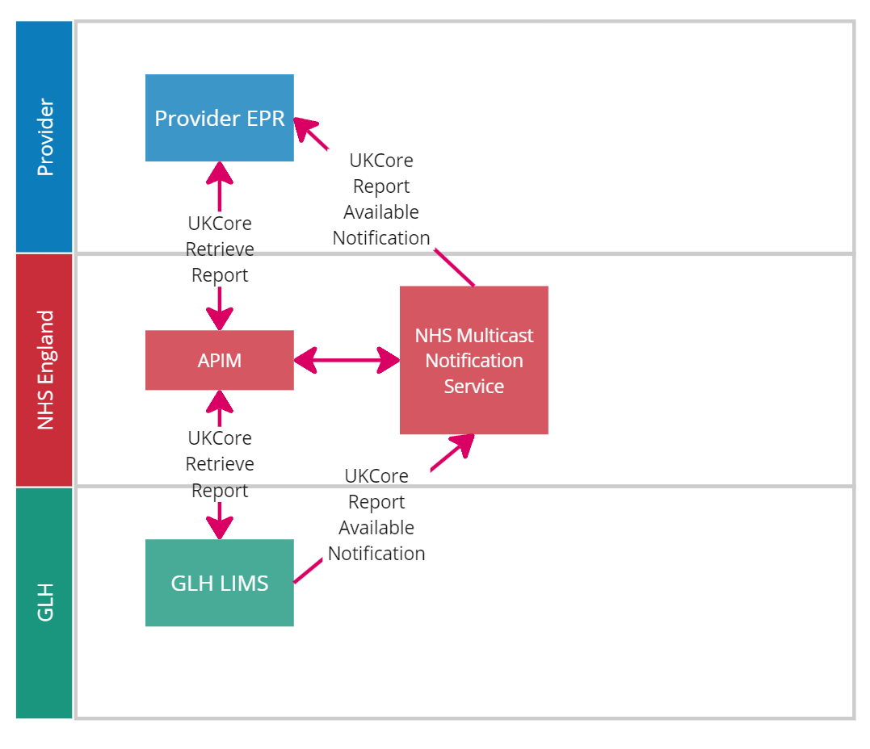
Results / Orders Pattern 4

Slide 15
Results / Orders Pattern 5

